Slide 1
On-path vs Off-path Traffic Steering, That Is The Question
Karima Saif Khandaker, Dirk Trossen, Jinze Yang, Zoran Despotovic, Georg Carle

Slide 2
Problem of Traffic Steering
1
Consider execution of services in distributed (e.g., virtualized) service environments:
A service, realized through a service instance, available in one or possibly more network locations
Service transaction requires affinity to a service instance after the initial service request due to possible ephemeral state created
Client initiates a service transaction, utilizing one of the possibly many service instances available
Problem: At which layer of the networked system shall we make the decision as to WHICH available instance we shall utilize?
Our Contribution: Outline systems-at-test for Layer 3/3.5 vs Layer 7 decisions and compare performance against number of aspects for the same, given, decision process

Slide 3








System-At-Test for Off-path Traffic Steering
2
Explicitly resolving service name into network locator
Done through explicit indirection infrastructure
Client issues resolution request first
Client then utilizes resolved network locator for the actual request
Example Technologies
DNS, DoH
Global Server Load Balancing (GSLB) for CDN-based load balancing – see later
ALTO (application layer traffic optimizations)
HTTP redirect
QUIC redirect for load balancing
QuicR (https://datatracker.ietf.org/doc/draft-jennings-moq-quicr-arch/)
Interesting mix between explicit but on-path resolution
Router
Service instance
Point-of-Presence
Indirection Infrastructure
service.org
service.org
foo.com
service.org
Client
Client

Slide 4

System-At-Test for On-path Traffic Steering
2
On-path resolution of service name onto network locator
Utilize on-path ingress node (OPIN) to take role of indirection infrastructure
Client issues service request to OPIN, which includes service payload!
OPIN maps service name onto network locator, forwarding packet to chosen instance
Realized either at L3 (direct path) or L3.5 as shim overlay (overlay path)
Example Technologies
Dyncast (https://datatracker.ietf.org/doc/draft-li-dyncast-architecture/) with on-path mapping of anycast IP onto IP unicast
Routing on service addresses (ROSA) [1], submitted as https://www.ietf.org/id/draft-trossen-rtgwg-rosa-00.html
On-Path Ingress Node (OPIN)
Router
Service instance
Point-of-Presence
Indirection Infrastructure
service.org
service.org
foo.com
service.org
Client
Client
[1] R. Khalili Z. Despotovic A. Hecker G. Carle K. Khandaker, D. Trossen. 2022. “CArDS: Dealing a New Hand in Reducing Service Request Completion Times”. In IFIP Networking.

Slide 5



Traffic Steering Algorithm: Compute-Aware Distributed Scheduling (CArDS)
3
1
Key Criteria:
Compute-aware
Little/no signaling overhead
Implementable at link speed
CArDS [1]:
Each service instance assigned a normalized compute (resource) unit
Compute units distributed to all OPINs as an identifier-specific routing identifier
Distributed scheduling as round robin over the identifier for each incoming service request
Implementable, e.g., in P4
2
2
1
3
1
4
5
SR5
6
7
8
9
Client
10
OPIN1
Routing Identifier
OPIN2
4
Client
Router
Service instance for foo.com/bar
2
OPIN
n
# of compute units per service instance
[1] R. Khalili Z. Despotovic A. Hecker G. Carle K. Khandaker, D. Trossen. 2022. “CArDS: Dealing a New Hand in Reducing Service Request Completion Times”. In IFIP Networking.

Slide 6
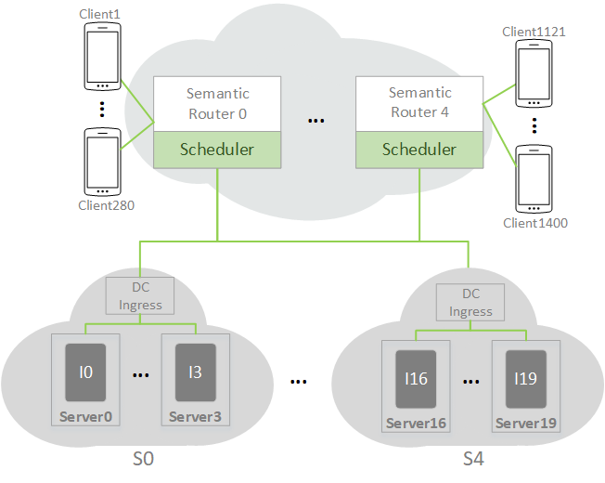
Simulation Setup
Event-based simulator using custom Python libraries
5 sites with 4 servers each and 1 service instance per server
Compute units assignment of instances defined at start
5 ingress semantic routers
All service requests are to one service function only, sent as single packet requests (all requests of one service identifier)
The network load is varied by configuring the total number of clients, distributed equally across 5 ingress semantic routers
100% workload is simulated using 1550 clients
Main metric is request completion time (RCT) of service requests
Notes:
Network load between 315 clients (20%) and 1710 clients (110%)
Mean request completion time (RCT) of service requests, refers to round trip time from issuing a request at the client, processing at one of the service instance and returning to the client

Slide 7
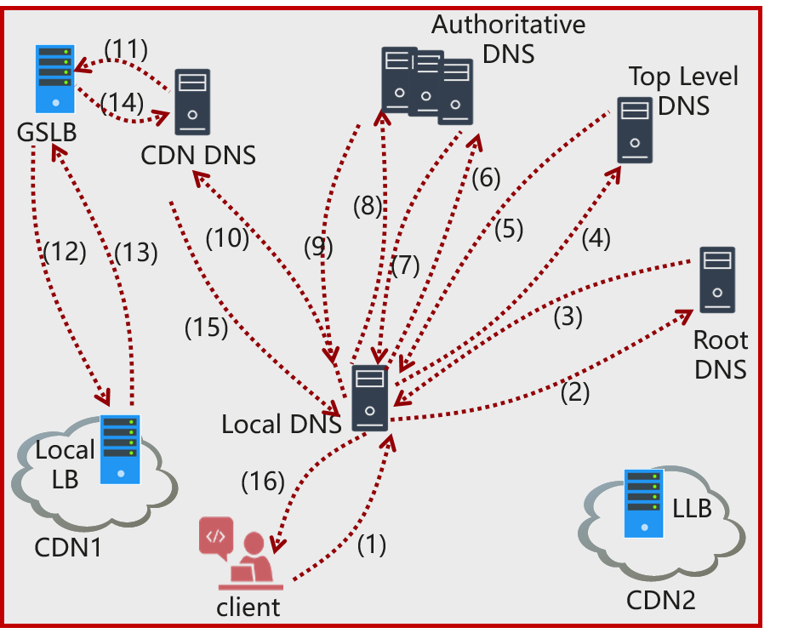
Key Insights (1)
4
Reduction of initial request latency
ON-path compared against GSLB (see right) with focus on best case, i.e., load balancing of CDN-hosted services -> 15 to 45ms latency (higher for DNS over HTTP solutions) -> On-path solutions do not incur this latency albeit shim layer routing may incur some additional path stretch (for further study) -> Also message count for indirection is high (see figure), e.g., with 4 messages crossing client link compared to just two for on-path
Impact of on-path distribution
Already evaluated in [1] but put into 5G context in aligning with scalability needs of 5G user plane function (UPF) deployment numbers of hundreds or even thousands of UPFs (user plane functions)
Also, rates for on-path resolution are distributed rather than going through explicit indirection architecture
Separate work on on-path systems looking to evaluate (prototypical) ingress forwarding performance (expected to be >100k req/s per ingress in initial measurements)
Distributing the DNS may be one way to cope with that, though, albeit with its own challenges!
[1] R. Khalili Z. Despotovic A. Hecker G. Carle K. Khandaker, D. Trossen. 2022. “CArDS: Dealing a New Hand in Reducing Service Request Completion Times”. In IFIP Networking.

Slide 8
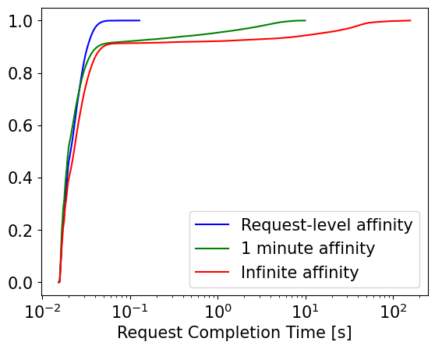
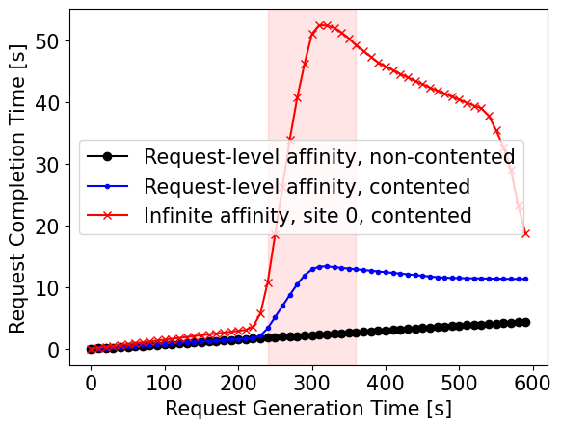
Key Insights (2)
4
Supporting small affinities
Similar to comparing M/M/k system with N clients against M/M/1 with N/k clients
Use case of AR/VR with 500ms max chunk retrieval (100ms average)
Average latencies hardly affected but significant reduction of latency variance, leading to smoother user experience
Impacting use case performance in resilience situations
Studied impact of failure of one service instance on overall latencies
Long affinities equally impact affect ALL clients in affected group
Small affinities lowered this impact by about 4.5 fold -> shared fate for small affinity realizations
Important insight: Problematic to apply small affinities in off-path systems to gain variance and resilience benefits
Would lead to ~6.2k DNS requests per second from this use case alone -> most DNS systems are rate limited and would not allow for such rates
Would exceed latency budget for use cases like AR/VR due to resolution latency

Slide 9
Conclusion
The answer to L3 vs L7 is largely driven by the needs for dynamicity of relations between client and the (compute) resources implementing the service instances
Hence, new scenarios like AR/VR, edge computing, distributed learning, …, may be the driver here!
Latency variance may be the biggest gain for having the ability to send to any of the possibly many service instances (without the latency penalties current L7 systems introduce)
Here even just random distribution (if all compute resources are equally dimensioned) suffices!
Fate sharing through virtualization can lead to better resilience across all clients
When combined with fast server failure reporting to OPINs, this may even improve on recovery times (not studied in our work)

